Slide 1
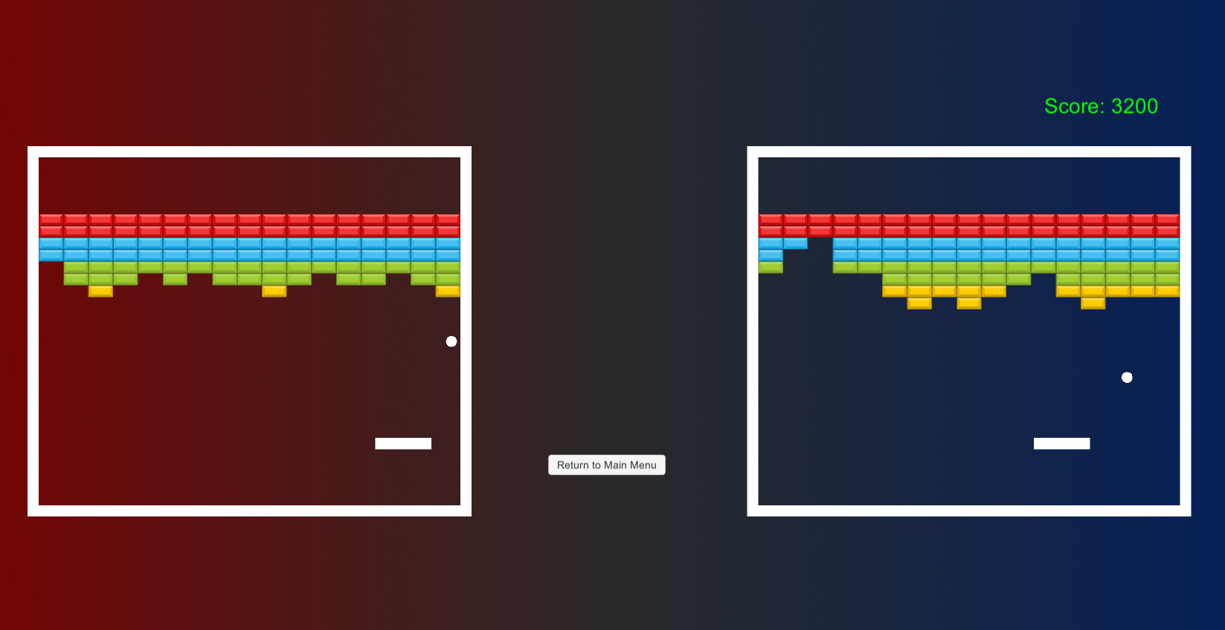
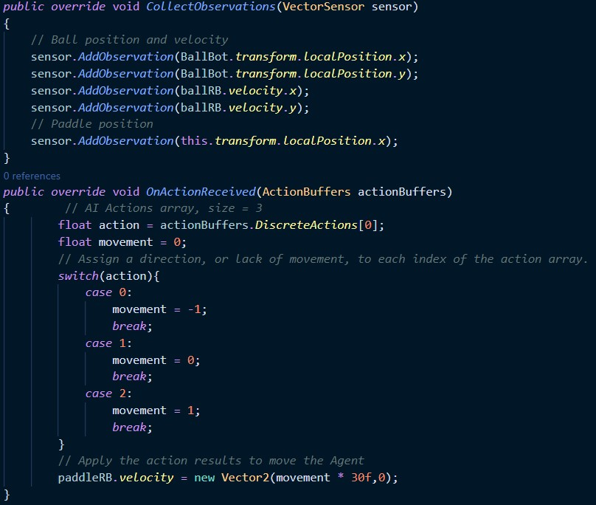
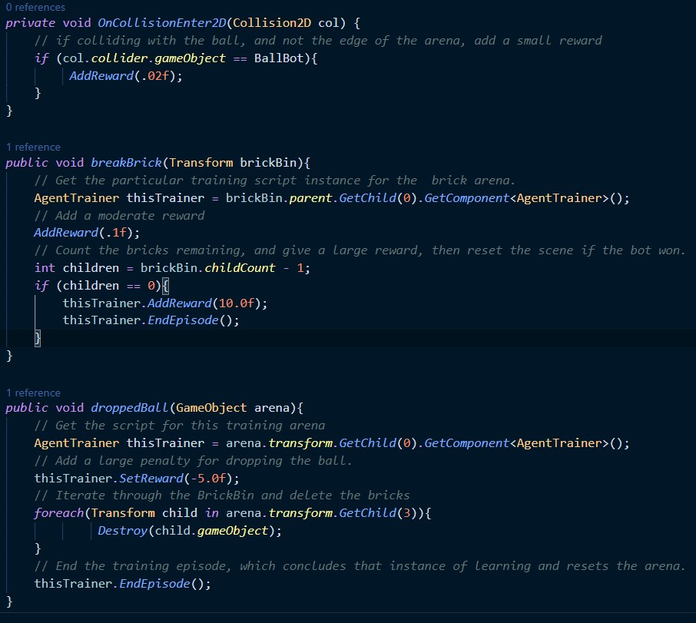
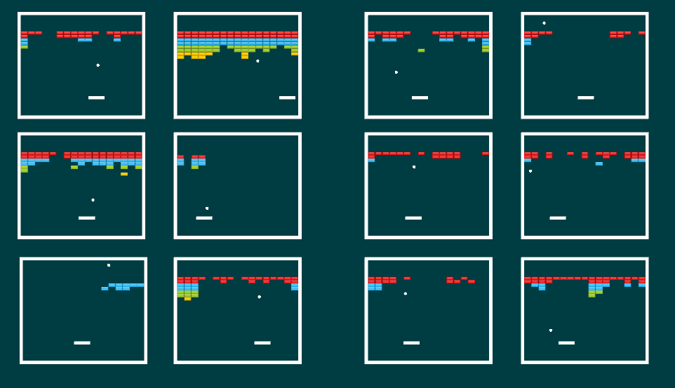
Team Sasquatch:
Chris Hauser
Dean Branaman
Bigfoot Breakout
Features
An Atari Breakout clone developed in Unity where players can compete against an AI adversary trained using Machine Learning(ML)
A port of the classic Breakout game into Unity. Physics are handled within Unity itself using RigidBody components and Box Colliders.
A user can select from the main menu to play against an AI controlled paddle of three difficulty levels or to watch the AI play on its own.
Unique game behaviors such as the ball reflection angle from the paddle or the placing/destroying of bricks are defined in their own C# script.
Game is complete with a score system, high score tracker, and sound effects.
This code block sets up the observations the agent makes to gather data in order to make decisions and take actions, which are specified in the OnActionReceived method.
Here the Agent is given a reward based on various scenarios. Hitting the ball, breaking a brick, winning the game, and losing the game all provide differing reward amounts.
The main game arena. The player controls the right side and the ML agent controls the left paddle.
Machine Learning Development
The AI paddle controllers were developed using the Unity ML Agents plugin. After overriding several default methods within a trainer script and adding in components to our paddle game objects, we were able to run a command to hook up our instance of Unity to the ML algorithms which build a model in Python.
During a training session, each agent within the training scene to the right contributes their learning and rewards towards the cumulative learning progress of an output model which we can then plug in as an AI controller for one of our three difficulty levels.
Proximal Policy Optimization(PPO), the most common algorithm used within the Unity ML Agents plugin, was used to develop all of our final agent brains. We experimented with the Soft Actor Critic algorithm but found more success with PPO.
In order to fine tune the learning speed and help the agent achieve convergence on a “solution,” or final ideal set of decision making parameters, we manipulated several variables which dictate the algorithm response to training within a configuration file. After incrementally changing each variable, it was necessary to rerun the training, which could take up to an hour in order to build intuition on how the models respond to variations in training parameters.
The agent brains which we use for our Easy, Medium, and Hard difficulty settings were created using the same training parameters but their model was captured after differing amounts of learning steps. Easy was captured at 50,000 steps, Medium at ~75,000, and Hard at 1 million.
The most successful training outputted a model that wins the game about 80% of the time.
Within this scene, each game arena is controlled by a separate instance of the machine learning agent brain, such that each bot makes decisions only regarding its own environment. Multiplying the training arena allowed us to train agents much faster than with a singular arena and agent, as was the case with our early iterations.

